Slide 1

Specification Demo
EKE 749 Group Assignment 2
Team 6, Code Monkeys.
Notes:
6조의 specification demo 발표를 맡은 이대홍입니다.
저희 조의 이름이 code monkeys이기 때문에 monkey그림을 올렸습니다.

Slide 2


Code Monkeys
Notes:
First, I explain code monkeys.
Code Monkeys has two means.
First is an American animated television program in the early 1980s.
Second, A Code monkey is a computer programmer or other person who writes computer code for a living.
This term may be slightly derogatory, meaning that this developer can write some code but is unable to perform the more complex tasks of software architecture, analysis, and design^{[1}
In other words, code monkey means not efficient person.
But, we use this name paradoxically.

Slide 3

Introduce
Group name : Code Monkey
Project name : Monkey Calendar
Notes:
So, our group name is code monkey.
And our project name is also about monkey.
This monkey seems very cute. Isn’t it?
So, Our project name is Monkey Calendar.

Slide 4
Contents
Objective
Features
Environment
Notes:
First, I introduce objective of this project.
And second, I introduce monkey calendar’s features.
This is consist of basic requirements and additional features.
And last, I explain our task environment.

Slide 5
Objective
Write a calendar and appointment scheduler system.
    Construct features, interface, limitation, etc..
    Add windowing (GUI) or browser interface, instead of just text
Notes:
This project’s object is writing a calendar and appointment scheduler system.
This system is Constructed by features, interface, limitation, etc…
Especially, we use windowing interface to emphasize visual impressions.
I will explain this parts in the back.

Slide 6
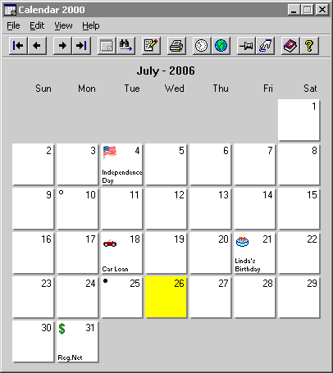
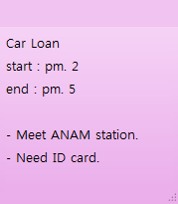
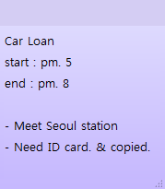
Print the calendar
Basic Requirements
Notes:
We use graphic user interface. It is called GUI.
So, I explain Monkey Calendar’s features using animation and picture.
First, I treat very fundamental calendar’s features.
This calendar’s picture is used just explain.
So our interface will be changed.
In this picture, calendar print year, month, day, and date.
It is calendar’s very basic function.
If user want record about appointment, click and write that like this.
Sure, it is possible to
change appointment or
Clear appointment.

Slide 7
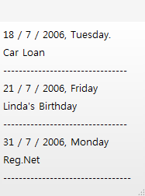

Save & Load
Basic Requirements
Load
Appointment1.MC
Save
Notes:
Next, if user sets appointments like this,
User can print all appointments for a given year, month, week, or day.
It’s good for seeing all appointments easily.
And we can save & load the set of all appointments to a file like this.

Slide 8

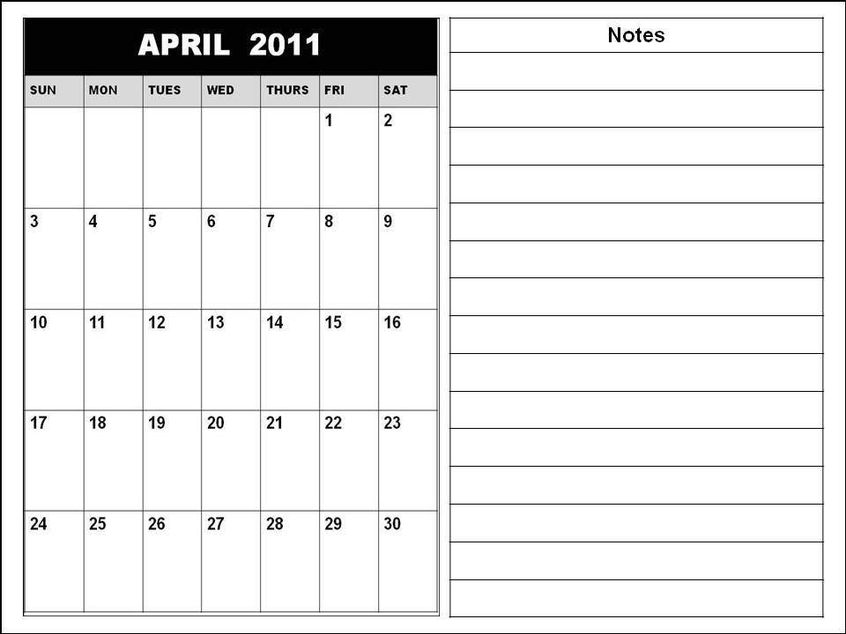
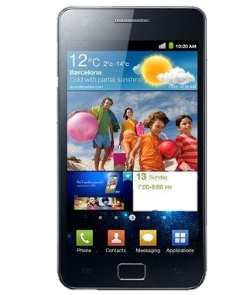
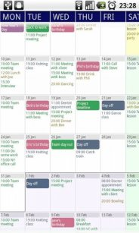
GUI interface
Additional fields
Notes:
To use GUI interface, we must select how to show this.
So, we decide to use android operating system.
We may using eclipse and we will test virtual machine and smart phone.
Sure, this calendar is just image from googling. Not monkey calendar.

Slide 9
Add additional fields
Additional features
FEBRUARY
Name
Car Loan
Day
2 / 4 / 2011
Start
Pm. 5
End
Pm. 8
Location
Seoul station
People
Car manager
Need ID card & copied
Description
Notes:
From this slide, I explain about monkey calendar’s additional function.
When we click that date, we can see detailed information.
Monkey calendar provides additional fields like location, people.
So user can classifies information easily.

Slide 10
Repeating Appointments
Additional fields
FEBRUARY
Name
Volunteer Work
Day
2 / 9 / 2011
Start
MARCH
Pm. 2
End
Pm. 7
Location
Korea univ.
People
Colleague
Sometimes location will be changed.
Memo
Notes:
Next, monkey calendar can repeat appointments.
User can repeats appointments every weeks.
Or every month.
It is useful setting appointments like card payment, weekend business report.

Slide 11
Spanning appointment
Additional fields
FEBRUARY
Name
Team meeting
Day
2 / 4 / 2011
2 / 4 ~ 2 / 8
Start
Pm. 5
End
Pm. 8
Location
Room. 312
People
Description
Notes:
Monkey calendar is also good for not one day appointment but also multiple days appointment.
If user assign appointment from Feb 4 to Feb 8, user easily sets this appointment by using drag from 4 to 8.

Slide 12
Reporting system
Additional fields
FEBRUARY
Name
Volunteer Work
Name
Team meeting
Day
2 / 4 / 2011
Day
2 / 4 / 2011
Start
Pm. 2
Start
Pm. 5
End
Pm. 7
End
Pm. 8
Location
Korea univ.
Location
Room. 312
People
Colleague
People
Is it OK?
Sometimes location will be changed.
Description
Description
Notes:
Monkey calendar reports if two appointments are at the same time.
For example, User sets appointment Feb 4.
But if user writes to set another appointment which is overlapped before appointment,
System show message about this.
If user doesn’t care about it, just pass this message.
And if user want to set overlaped appointment, just click OK.

Slide 13
Holiday & Lunar calendar
Additional fields
MAY
Lunar Calendar
4 / 4 / 2011
Children’s day
Lunar Calendar
4 / 8 / 2011
Buddha's Birthday
Lunar Calendar
4 / 18 / 2011
Notes:
Next, It show holiday & lunar calendar.
For example, this calendar show MAY.
We can see children’s day and buddha’s birthday easily.
And if you want,
You can see Lunar calendar.
We usually use solar calendar.
But sometimes we need lunar calendar.
This function is good for that time.

Slide 14
Adding Tasknote
Additional fields
MARCH
July
Keep household accounts
Write self-introduction
Repair notebook
Notes:
Next, Monkey calendar has additional tasknote.
It always keep staying under the calendar.
달이 바뀌어도 tasknote는 항상 유지되기 때문에, 중요한 정보를 적어놓기 좋다.

Slide 15
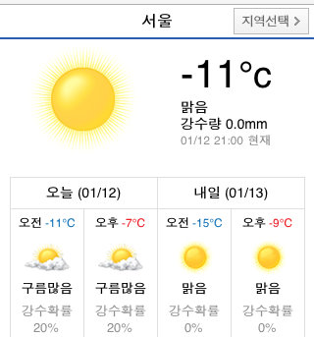
Day’s information
Additional fields
Biorhythm
Weather
Myfortune
Link
Notes:
Every day, Monkey calendar provides funny information.
We provide three day’s information.
Biorhythm, weather, and my fortune.
If user click weather,
User can see that day’s weather through link.
In other words, user must uses internet.
Biorhythm and Myfortune are also provided by link.

Slide 16
Additional Language
Additional fields (optional)
FEBRUARY
MARCH
Volunteer Work
Name
Volunteer Work
Name
Day
3 / 9 / 2011
Day
2 / 9 / 2011
Start
Pm. 2
Start
Pm. 2
Pm. 7
End
Pm. 7
End
Location
Korea univ.
Location
Korea univ.
People
Colleague
People
Colleague
Sometimes location will be changed.
Sometimes location will be changed.
Description
Memo
Notes:
Additional language의 경우 monkey calendar에 확실히 포함될지는 모르기 때문에 optional fields 입니다.
만약 user가 원한다면, 설정을 통해 language를 변환할 수 있습니다.
현재는 English와 Korean을 지원할 예정입니다.

Slide 17
Additional Language
Additional fields (optional)
FEBRUARY
내용
3월
Volunteer Work
제목
Volunteer Work
Name
일
월
화
수
목
금
토
날짜
3 / 9 / 2011
Day
2 / 9 / 2011
시작시간
Pm. 2
Start
Pm. 2
Pm. 7
끝 시간
Pm. 7
End
장소
Korea univ.
Location
Korea univ.
사람
Colleague
People
Colleague
Sometimes location will be changed.
Sometimes location will be changed.
추가 설명
Memo

Slide 18
Monkey Calendar
Environment
  Android version : 2.1
  Resolution : 800 x 480 WVGA
  Input device : touch, virtual keyboard

Slide 19

Ask me anything!

